Slide 1
R and RStudio installation
R: https://cloud.r-project.org/
RStudio: https://posit.co/download/rstudio-desktop/

Slide 2

Introduction to R
Paul Blakely, Clara Tang

Slide 3
Learning objectives of today
Control Structures & Data Manipulation in R
Conditional statements and logical operators
Looping constructs: for, while, repeat
Sub-setting and filtering data
Adding and renaming variables
Sorting and merging datasets
dplyr and tidyr packages
Data Visualization
Introduction to ggplot2
Creating basic plots: scatter plots, histograms, bar plots
Adding trendlines and handling missing data
Customizing plots: colours, themes etc.
Advanced plotting techniques

Slide 4
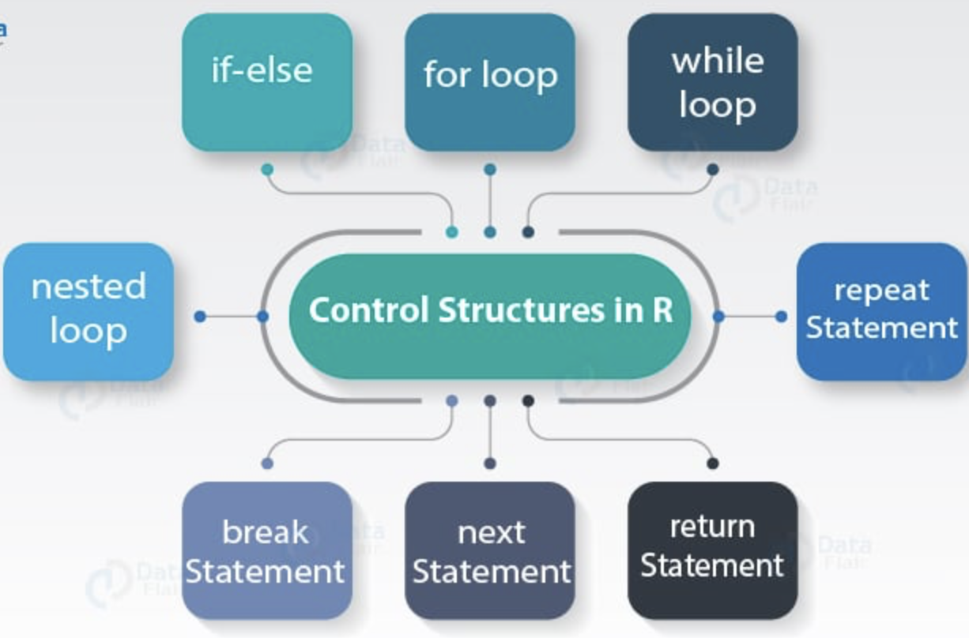
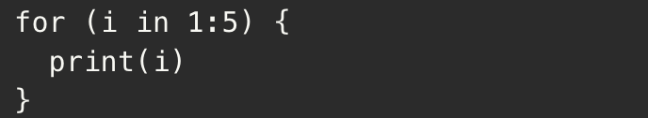
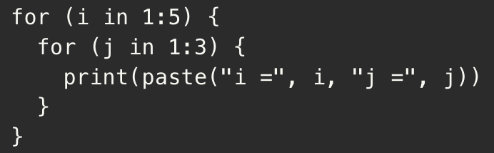
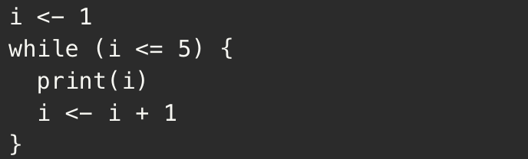
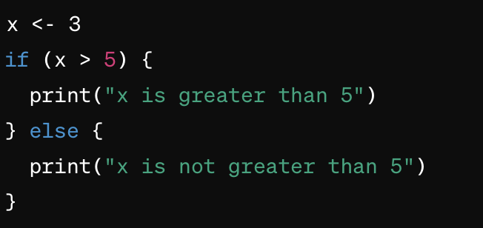
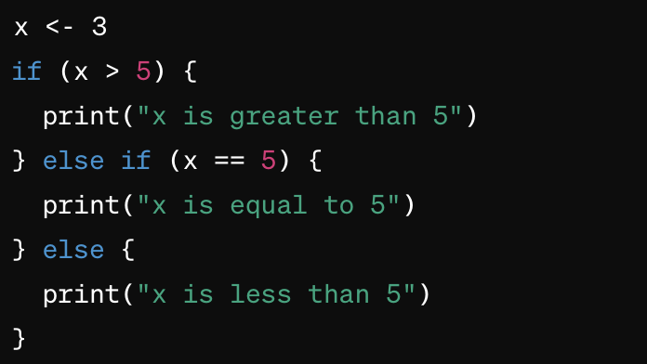
Control structures in R
Control structures in R are fundamental for controlling the flow of execution in the code.
For loops: used to iterate over a sequence or a collection of elements
While loops: used when you want to iterate until a condition is no longer true.
Conditional statements (if-else, else if): allow execution specific blocks of code based on certain conditions.
Basic for loop
Nested for loop
if-else
else-if

Slide 5
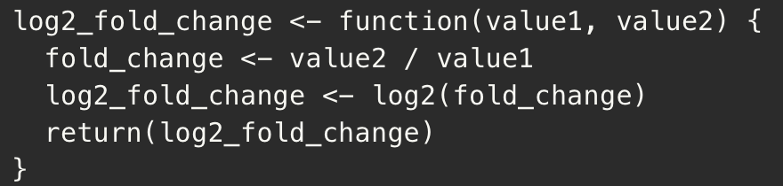
Apply() functions
Apply() performs functions simultaneously on multiple elements of a matrix or data frame.
Vectorization using apply() results in much faster computations compared with for loops, which iterate sequentially across elements.
apply() allows for more concise and readable code
Different variations of apply() such as lapply() and sapply() can be used on lists or vectors.
For loop
Vectorize using apply()
Cond A
Cond B
Cond A
Cond B
Log2FC
3
6
1
Log2FC
Gene A
3
6
1
Log2FC function
Log2FC
4
12
4
12
Gene B
1.6
1.6
5
10
-1
5
10
-1
Log2FC
Gene C
2
10
2
Log2FC
Gene D
2
2
10

Slide 6
When to use Apply() vs For Loops
Apply() is faster and and more efficient as it leverages the underlying C code
Apply() is especially useful when working with numeric data stored in matrices or lists (e.g. most Omics datasets)
However For loops provide more flexibility with more control over complex operations (e.g. nested loops)
Better for complex datasets such as electronic health records
For loops can be more memory-efficient when dealing with large datasets
 | For Loop | Apply()
Data structures | Dataframe, lists, non-rectangular data | Matrix, Numeric, Vectors
Execution performance | Memory-efficient | Fast
Code writing | Verbose | Concise

Slide 7
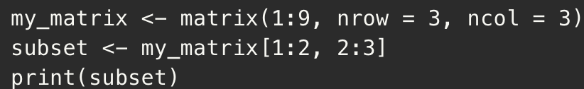
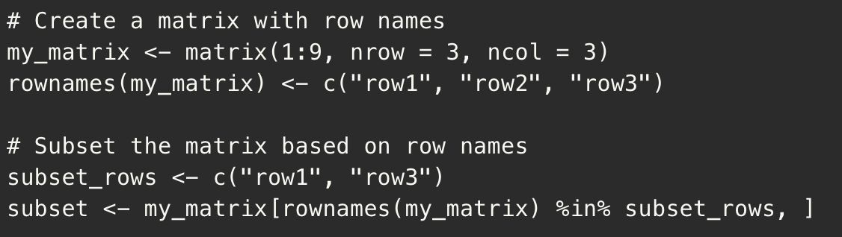
Subseting and Filtering data
Sub-setting: extracting specific elements or subsets of data from a larger data structure, such as a vector, matrix, list, or data frame.
There are several ways to subset data in R, including using indexing, logical conditions, and column/row names.
Filtering rownames a using list of genes
Sub-setting using indexing
Patient Sample
P1
P2
P3
P2
P3
Gene A
3
2
7
Gene A
2
7
P1
P2
P3
List
Gene A
Gene c
P1
P2
P3
Gene
Gene B
12
9
4
Gene B
9
4
Gene A
3
2
7
Gene A
3
2
7
Gene B
12
9
4
Gene C
1
4
4
subset
Gene C
1
4
4
my_matrix
Gene C
1
4
4
subset
my_matrix

Slide 8
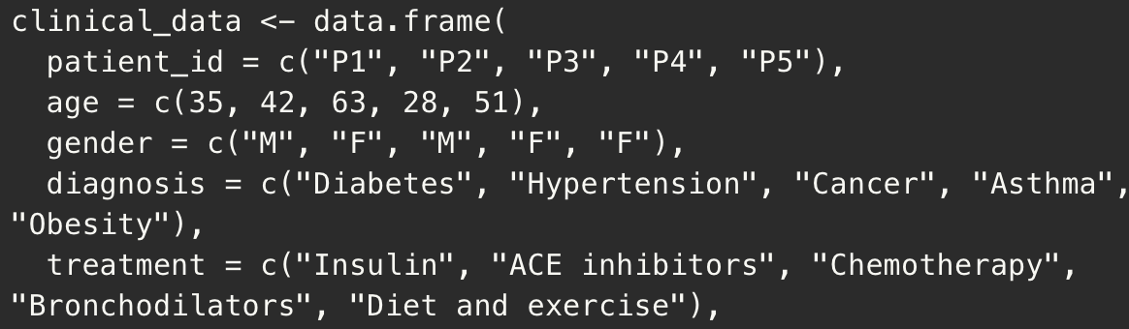
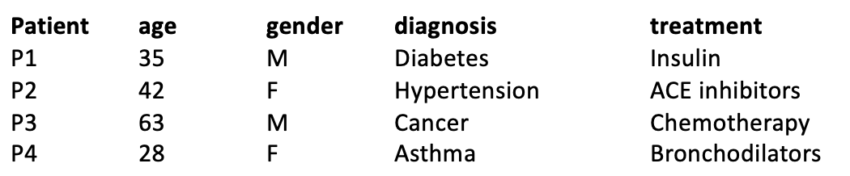
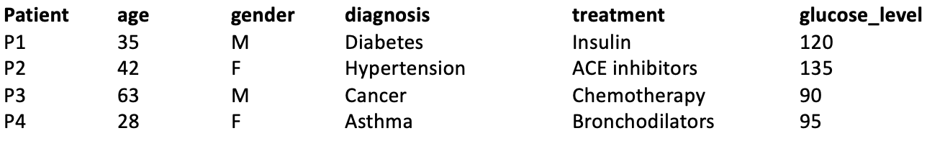
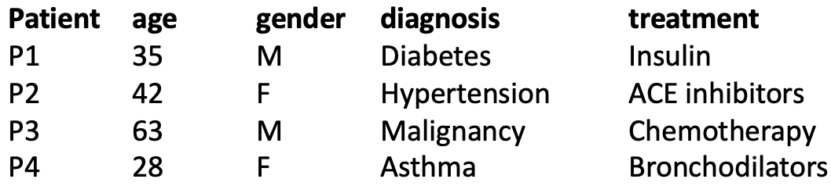
Dataframe variables
Create dataframe “clinical_data”
Dataframe are two-dimensional tabular data structures that are commonly used to store clinical data.
For a dataframe named ‘clinical_data’ with existing columns like "patient_id", "age", and ”diagnosis", you can add a column for glucose levels using the `$` operator.
To change the values of an existing variable in the dataframe, you can use sub to change “Cancer” to “Malignancy”
Add “glucose_level” column
Change “Cancer” to “Malignancy”

Slide 9
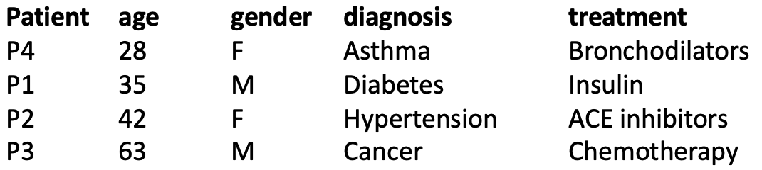
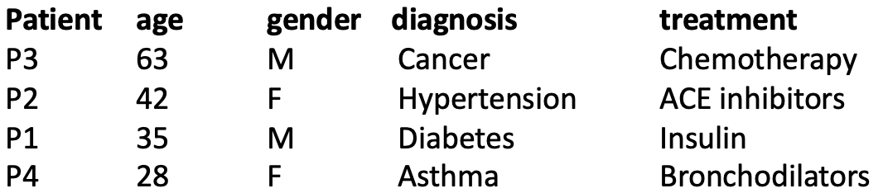
Sorting datasets in R
clinical_data
The `order()` function is used to sort datasets.
We can sort the clinical_data dataframe by age in ascending or descending order()
Sort by age (ascending)
Sort by age (descending)

Slide 10
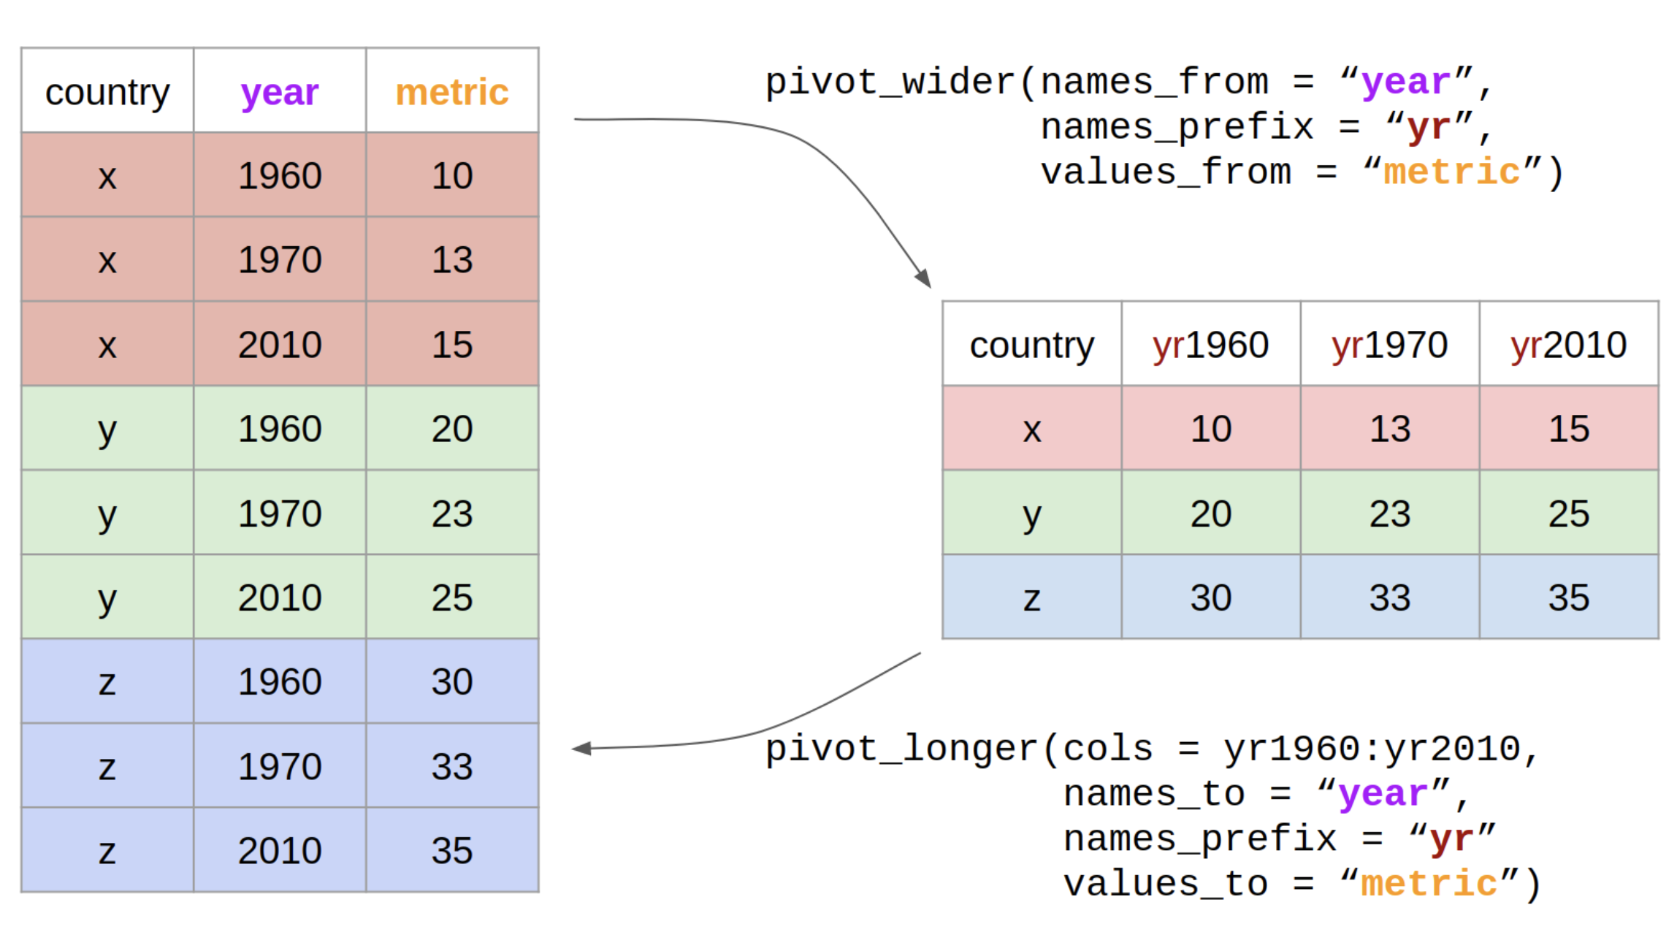
Non-base packages for data manipulation
dplyr and tidyr are non-base r packages that need to be installed separately using “install.packages()” function.
Useful for more advanced data manipulations techniques such as reshaping and grouping by specific columns.

Slide 11
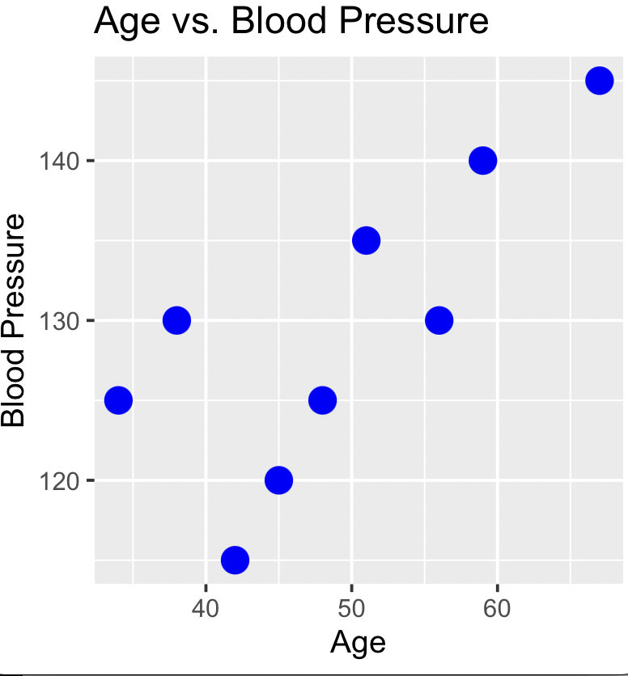
Introduction to ggplot2
Patient_data
Age BP
1 45 120
2 56 130
3 34 125
4 67 145
5 51 135
6 42 115
7 59 140
8 38 130
9 48 125
ggplot2 is a widely used data visualization package in R.
ggplot2 follows a layered approach, where you add different layers to a plot to build up the desired visualization.
Flexible and easy to modify
`patient_data` contains patient info, including age and blood pressure readings. We want to create a scatter plot to visualize the relationship between age and blood pressure.

Slide 12
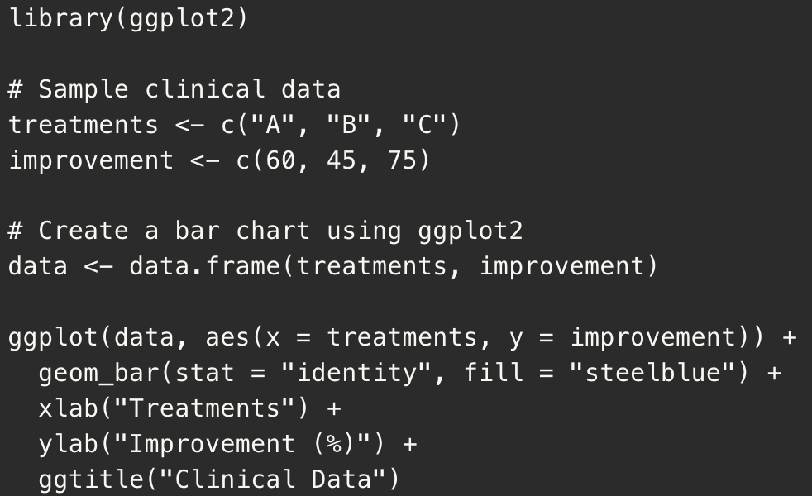
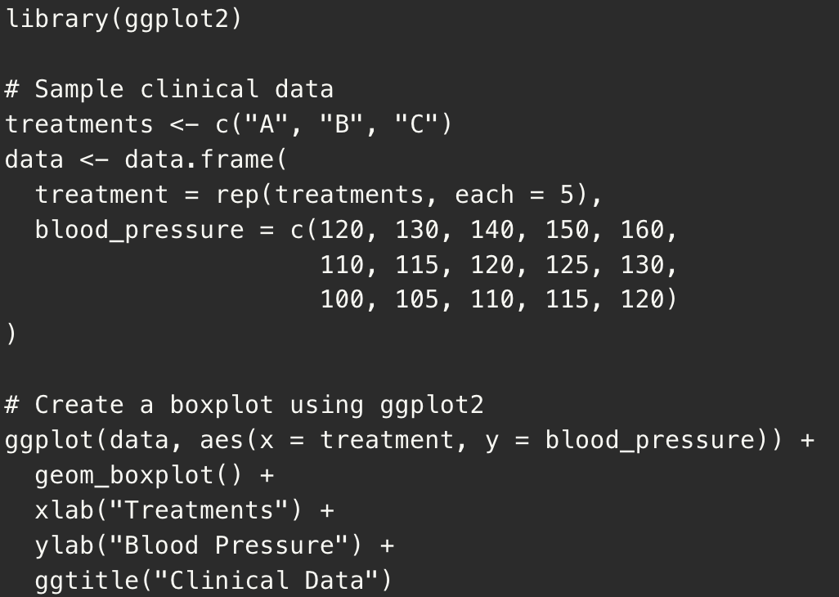
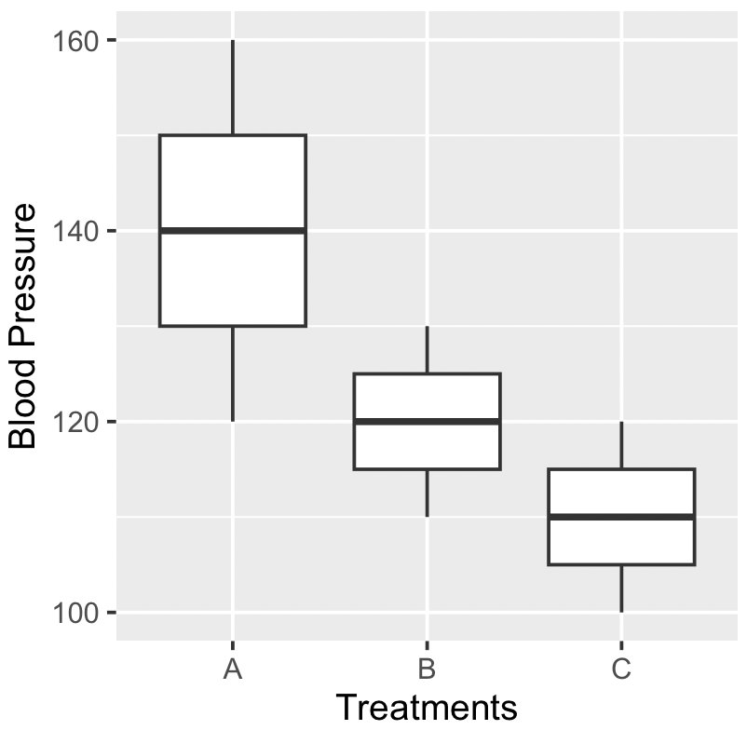
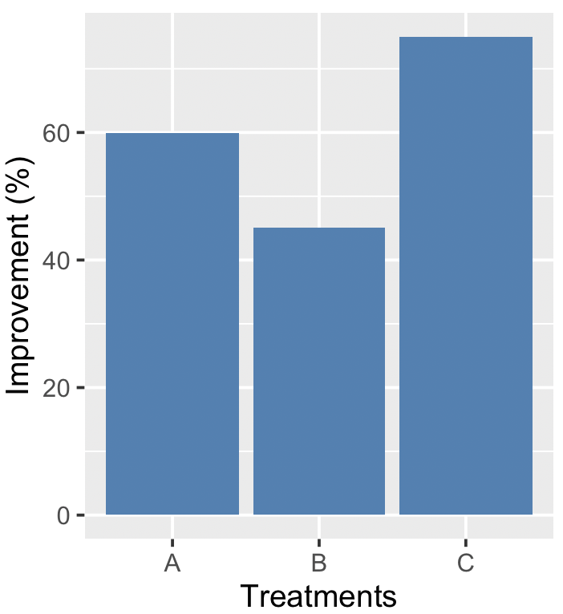
Other basic plots

Slide 13
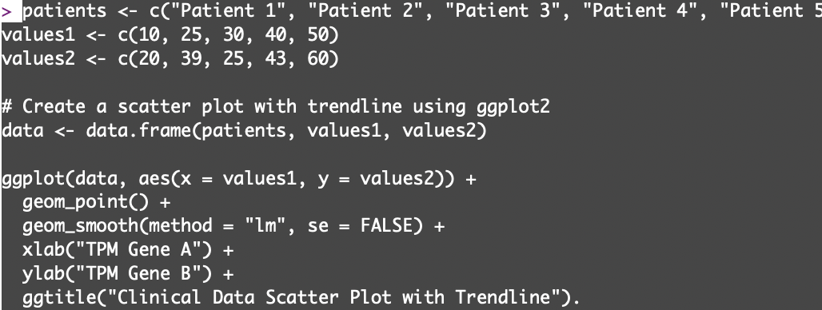
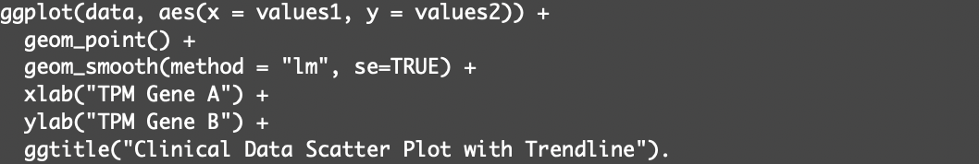
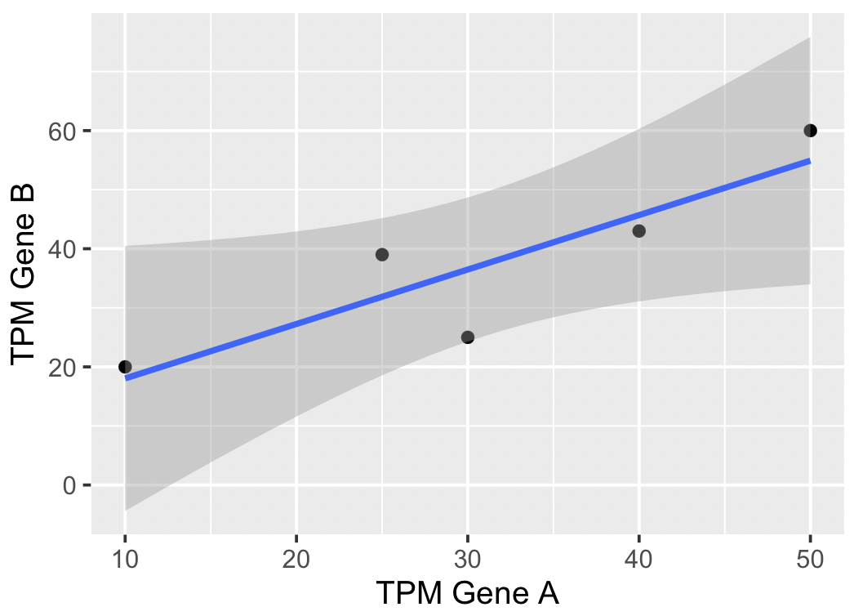
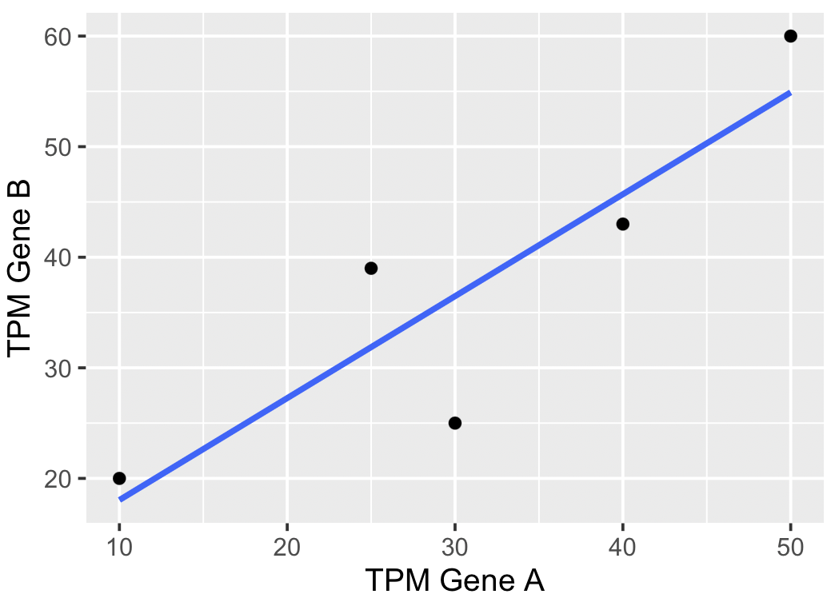
Adding trendlines to scatterplots
Linear regression line
Linear regression line with standard error

Slide 14
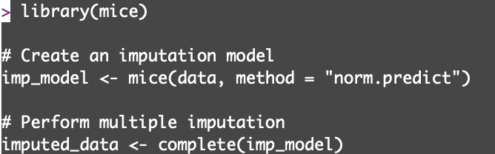
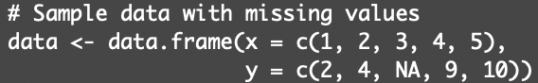
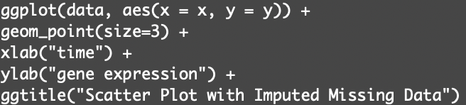
Handling missing data through imputation
MICE (Multivariate Imputation via Chained Equations) is a popular R package for imputation
We can create an imputation model using the `mice()` function.
We can specify the data frame `data` and the imputation method as "norm.predict", which uses linear regression to impute missing values.
x y
1 2
2 4
3 Na
4 9
5 10
x y
1 2
2 4
3 6.25
4 9
5 10

Slide 15
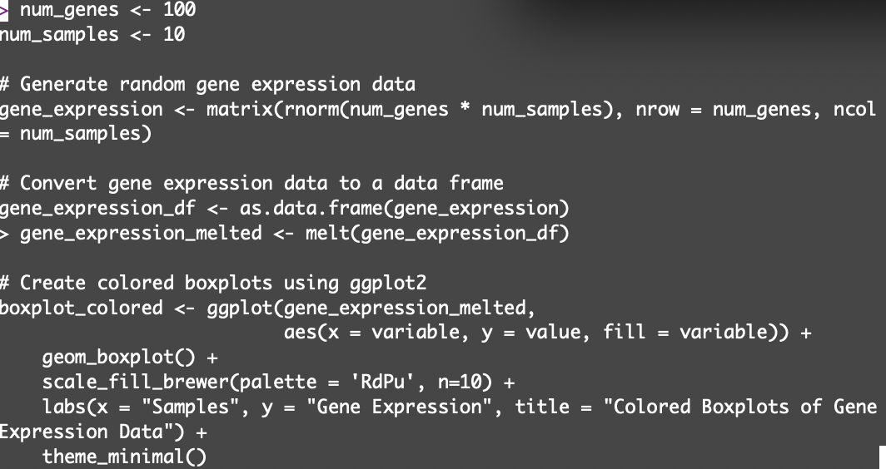
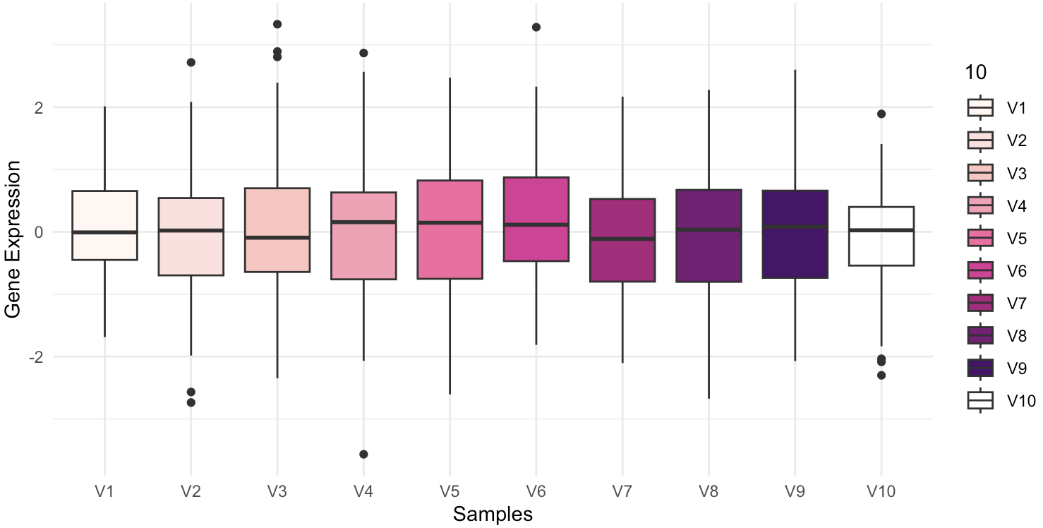
Customizing plots in ggplot2
scale_fill_brewer() from the ColorBrewer package contains predefined color schemes which can be added to ggplot2 plots: https://r-graph-gallery.com/38-rcolorbrewers-palettes.html
Viridis is another package that provides colour maps (all colourblind friendly) https://cran.r-project.org/web/packages/viridis
The theme() function is used for changing plot aesthetics such as gridlines and background with predefined styles.

Slide 16
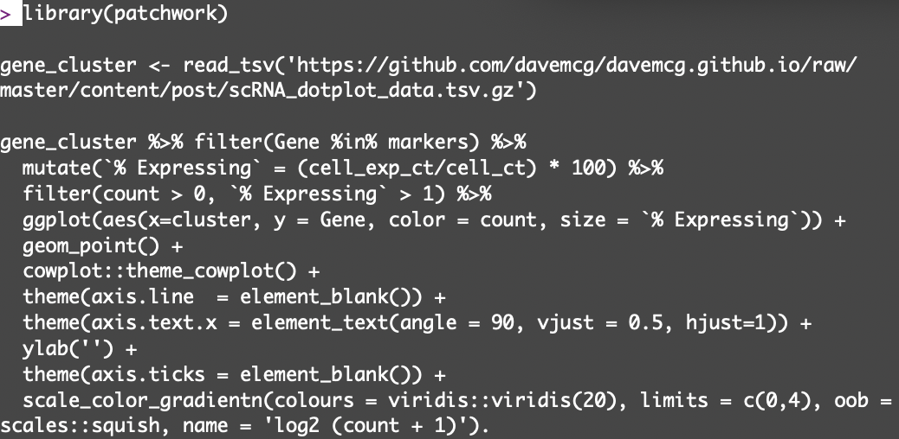
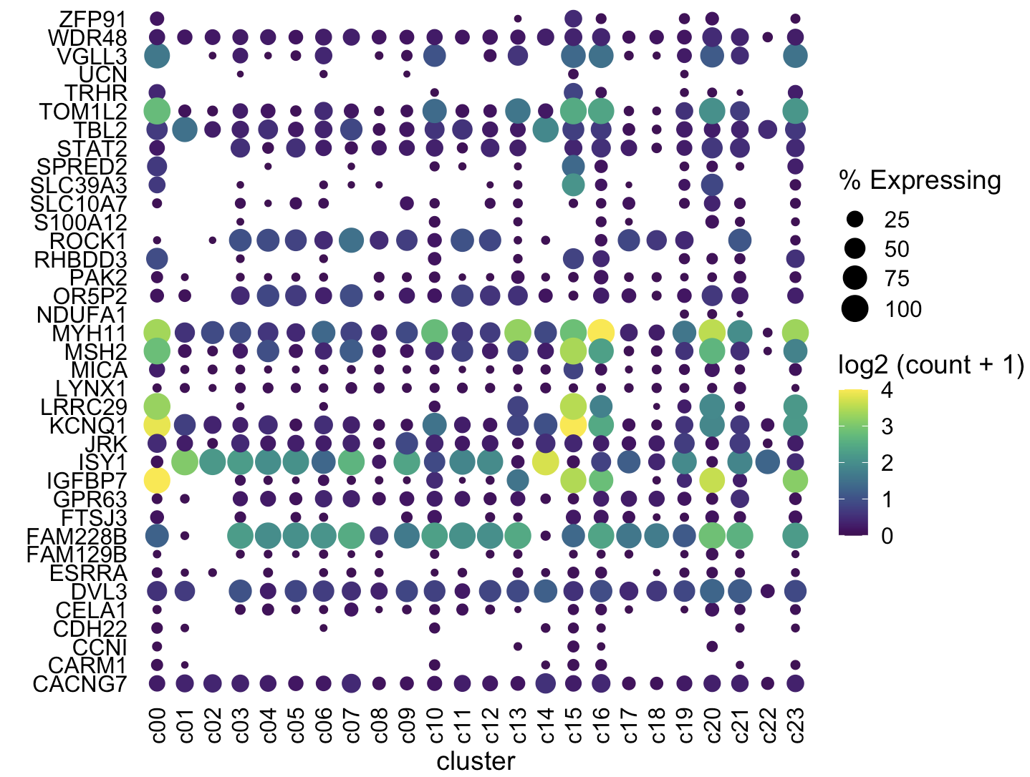
Advanced plotting
Gene expression dotplots are often used to visualize Single cell RNA-seq data.
Colour intensity = log2(count+1)
Dot size = proportion of cells expressing gene
Apart from ggplot2, other packages required such as:
Cowplot for improved aesthetics
Viridis for colour schemes
dplyr for modifying columns
https://davemcg.github.io

Slide 17
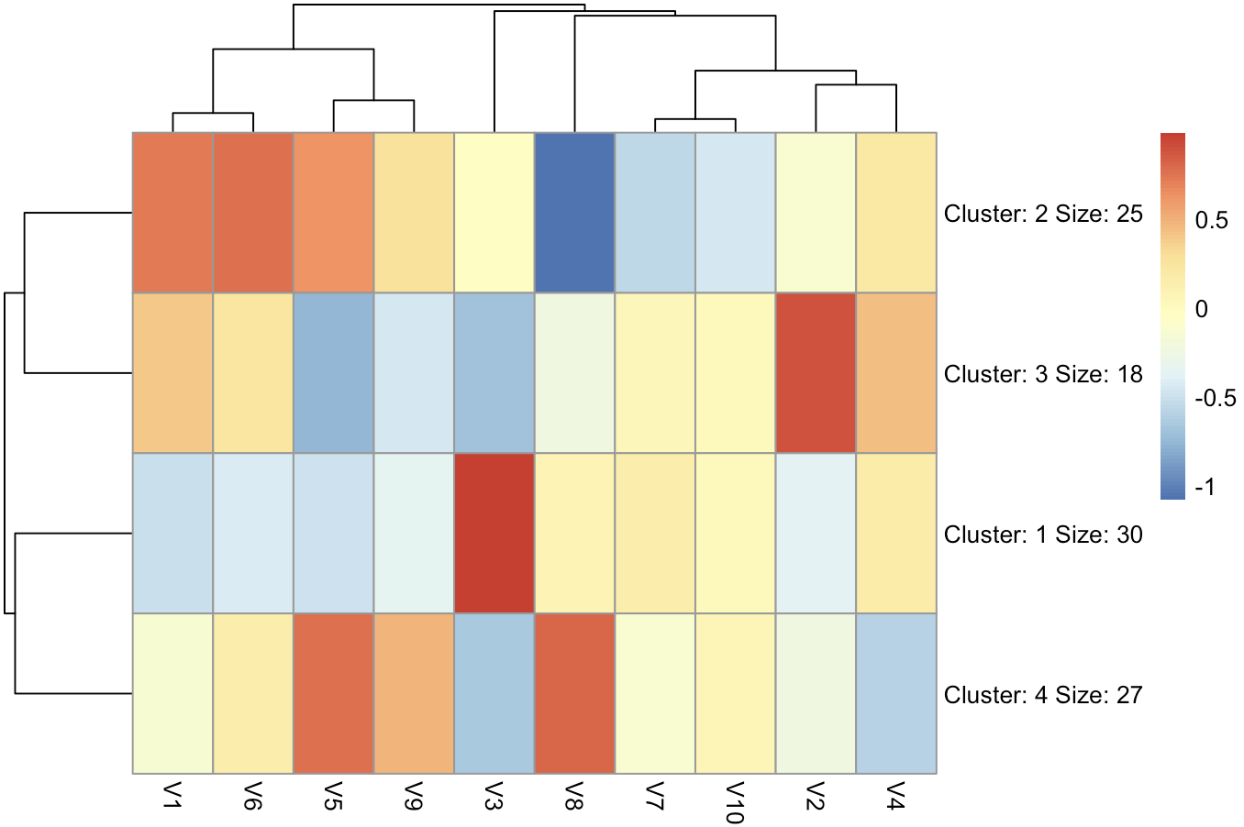
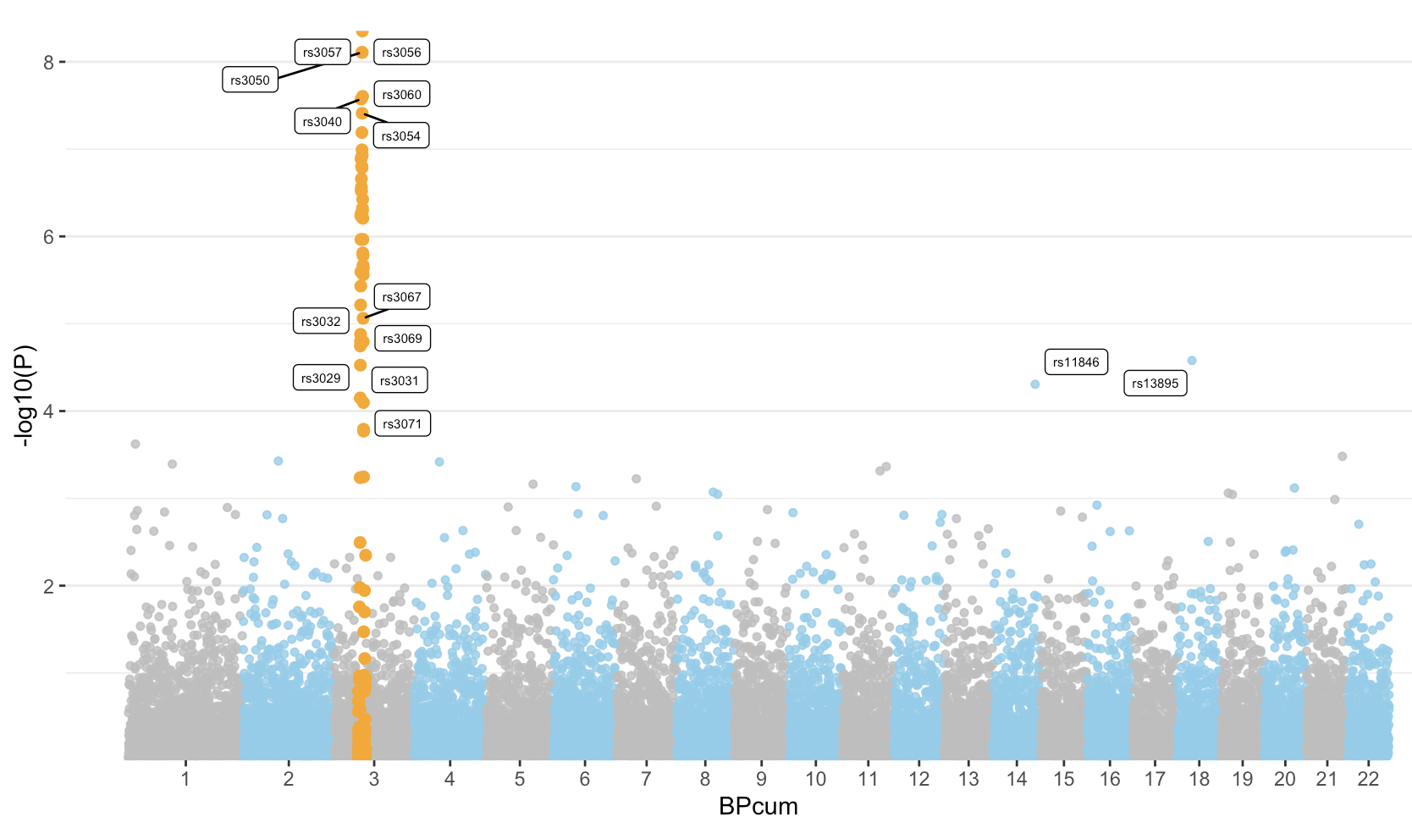
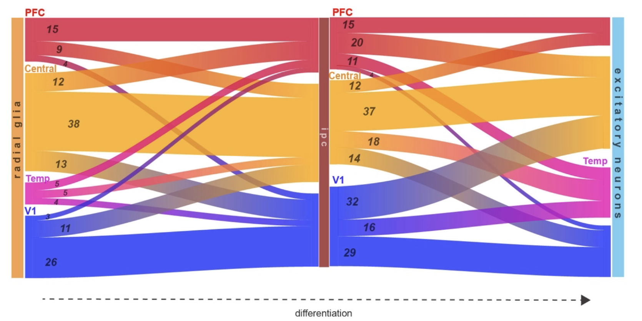
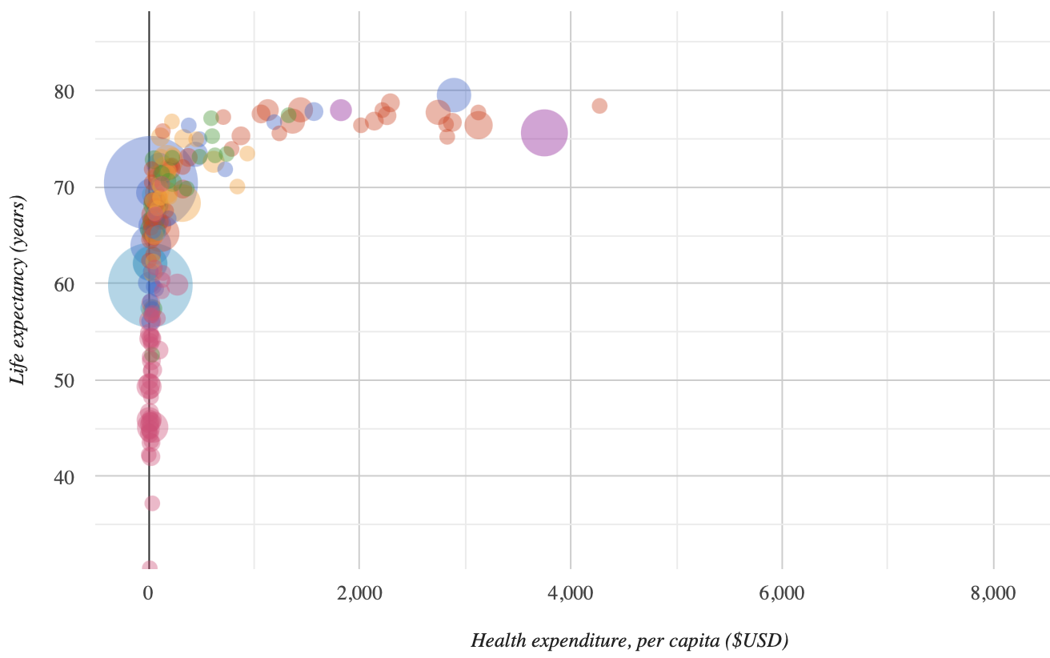
Other R packages for data visualization
pheatmap
Plotly
ggvis
Shiny

